Slide 1



Prototype Solution – Extraction and Analysis of Text from Insurance Claim Speech
A common way to make a claim with an insurance company is through a recorded phone call.
An .mp3 file of the call is stored by the company, requiring human intervention to document the information in the recordings into a structured format. This information could be used to generate customer and accident report insights from the audio available.
Website
AWS
Audio file loaded to S3
Amazon Simple Storage Service (S3)
AWS Sagemaker
Jupyter Notebook
AWS Transcribe
Text analytics summary returned
Audio file converted to JSON text
Using AWS services such as AWS Transcribe and AWS Sagemaker, we’ve built a working prototype to automate the transformation of audio files to text and applying Natural Language Processing techniques so that the insurance company can analyse the content and help to build up a claim assessment faster and more efficiently.
Copyright © 2020 Accenture. All rights reserved.

Slide 2
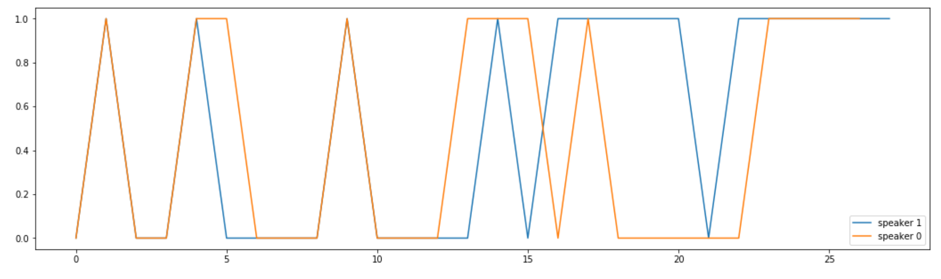





Prototype Solution – Extraction and Analysis of Text from Insurance Claim Speech
Text Preprocessing
Knowledge Graph
Sentiment Analysis
(see image below)
Remove extra whitespaces
Expand contractions
Remove special characters
Lowercase all texts
Convert number words to numeric form
Remove stopwords
Lemmatization
Replacing pronouns with speakers
English multi-task CNN trained on OntoNotes provided by spaCy that assigns context-specific token vectors, POS tags, dependency parse and named entities
Analysis split by speaker of positive/ negative / neutral speech using the Hugging Face model
Copyright © 2020 Accenture. All rights reserved.

